Slide 1
텐서플로와 머신러닝으로 시작하는
자연어처리
Lecture 3

Slide 2
Text Classification

Slide 3
Text Classification
What is Text Classification?
Why do we need Text Classification?
Text Classification Dataset
How do we evaluate Text Classification Model?
How does Text Classification work?
Classification Papers
Convolutional neural networks for sentence classification
Character-level Convolutional Networks for Text Classification

Slide 4
What is Text Classification

Slide 5
Text Classification
다양한 Natural Language Processing Task 중 가장 기본이 되는 Task
주어진 Source Text를 Pre-Defined된 Class들로 분류함.

Slide 6
Text Classification
다양한 Natural Language Processing Task 중 가장 기본이 되는 Task
주어진 Source Text를 Pre-Defined된 Class들로 분류함.

Slide 7
Text Classification
다양한 Natural Language Processing Task 중 가장 기본이 되는 Task
주어진 Source Text를 Pre-Defined된 Class들로 분류함.
SPAM!

Slide 8
Text Classification
다양한 Natural Language Processing Task 중 가장 기본이 되는 Task
주어진 Source Text를 Pre-Defined된 Class들로 분류함.
2 Class Classification: Binary Classification
N Class Classification: Multiclass Classification or Multilabel Classification

Slide 9
Why do we need Text Classification

Slide 10
Why do we need Text Classification
Spam Filtering
주어진 Text를 Spam인지 아닌지 분류(Binary Classification)

Slide 11
Why do we need Text Classification
Spam Filtering
주어진 Text를 Spam인지 아닌지 분류(Binary Classification)
Input Text
(광고)★월간 십일절★ 장바구니 7천원 쿠폰 + T멤버십~22%혜택
시스템옴므, 왕겜, 지오다노, 앤드지, 헨리코튼, 닥터자르트, 직구
안녕하세요 미팅 관련 연락드립니다!

Slide 12
Why do we need Text Classification
Spam Filtering
주어진 Text를 Spam인지 아닌지 분류(Binary Classification)
Input Text
(광고)★월간 십일절★ 장바구니 7천원 쿠폰 + T멤버십~22%혜택 => Spam
시스템옴므, 왕겜, 지오다노, 앤드지, 헨리코튼, 닥터자르트, 직구 => Spam
안녕하세요 미팅 관련 연락드립니다! => Not

Slide 13
Why do we need Text Classification
Sentiment Analysis
주어진 Text를 주어진 감정을 분류 (Binary or Multiclass Classification)

Slide 14
Why do we need Text Classification
Sentiment Analysis
주어진 Text를 주어진 감정을 분류 (Binary or Multiclass Classification)
긍정 or 부정

Slide 15
Why do we need Text Classification
Sentiment Analysis
주어진 Text를 주어진 감정을 분류 (Binary or Multiclass Classification)
긍정, 중립, 부정
아주 나쁨, 나쁨, 보통, 좋음, 아주 좋음

Slide 16
Why do we need Text Classification
Sentiment Analysis
주어진 Text를 주어진 감정을 분류 (Binary or Multiclass Classification)
Input Text
소재는 좋지만 감독의 연출이 말아먹은 좋은예
퇴근후 영화보면서 야식에 혼술하는거 완전 세상행복한건데 왜케 불행하게 묘사해놨냐
눈물날뻔했다.. 마블의 끝이며 시작
부정
부정
긍정

Slide 17
Why do we need Text Classification
Sentiment Analysis
주어진 Text를 주어진 감정을 분류 (Binary or Multiclass Classification)
https://app.monkeylearn.com/main/classifiers/cl_pi3C7JiL/

Slide 18
Why do we need Text Classification
Language Detection
주어진 Text의 Language를 Classification
https://app.monkeylearn.com/main/classifiers/cl_Vay9jh28/

Slide 19
Why do we need Text Classification
Application
SNS Monitoring
Brand Monitoring
Intent Classification in Dialogue System
Voice of Customer Classification

Slide 20
Text Classification Dataset

Slide 21
Text Classification Dataset
Sentiment Analysis
IMDb Dataset
SST-2 Dataset
SST-5 Dataset
Yelp Review Dataset
Text Classification
AG News Corpus
DBpedia Ontology Dataset

Slide 22
Text Classification Dataset
Sentiment Analysis
IMDb Dataset
SST-2 Dataset
SST-5 Dataset
Yelp Review Dataset
Text Classification
AG News Corpus
DBpedia Ontology Dataset
IMDb Dataset
Binary Classification Dataset(긍정 or 부정)
Internet Movie Database (IMDb) 사이트의 Review들을 평점에 따라 라벨링함
7점 이상 => 긍정
4점 이하 => 부정
전체 50,000개

Slide 23
Text Classification Dataset
Sentiment Analysis
IMDb Dataset
SST-2 Dataset
SST-5 Dataset
Yelp Review Dataset
Text Classification
AG News Corpus
DBpedia Ontology Dataset
SST Dataset
Stanford Sentiment Treebank
Sentence가 Tree구조로 되어있는 Dataset
영화 리뷰 text로 구성
SST-2
Binary Class (긍정, 부정)
56,400개
SST-5
Multi Class (5 단계)
94,200개

Slide 24
Text Classification Dataset
Sentiment Analysis
IMDb Dataset
SST-2 Dataset
SST-5 Dataset
Yelp Review Dataset
Text Classification
AG News Corpus
DBpedia Ontology Dataset
SST Dataset

Slide 25
Text Classification Dataset
Sentiment Analysis
IMDb Dataset
SST-2 Dataset
SST-5 Dataset
Yelp Review Dataset
Text Classification
AG News Corpus
DBpedia Ontology Dataset
Yelp Review Dataset
크라우드 소싱 리뷰 포럼인 Yelp의 리뷰로 구성
전체 500,000개
SST Dataset과 마찬가지로 2가지 종류로 라벨링
Binary Class
5 Class

Slide 26
Text Classification Dataset
Sentiment Analysis
IMDb Dataset
SST-2 Dataset
SST-5 Dataset
Yelp Review Dataset
Text Classification
AG News Corpus
DBpedia Ontology Dataset
AG News Corpus
AG News Corpus로 구축된 데이터셋
30,000개의 Training Data
Class 당 1,900개의 Test Data
총 4개의 Class
World
Sports
Business
Sci/Tech

Slide 27
Text Classification Dataset
Sentiment Analysis
IMDb Dataset
SST-2 Dataset
SST-5 Dataset
Yelp Review Dataset
Text Classification
AG News Corpus
DBpedia Ontology Dataset
DBpedia Ontology Dataset
DBpedia의 title과 content로 구성
전체 14개의 Class
e.x) Company, Educational, …
560,000개의 Training Data
각 Class마다 70,000개의 Test Data

Slide 28
How do we evaluate Text Classification Model

Slide 29
How do we evaluate Text Classification Model
Error
실제 값과는 다르게 예측을 한 경우

Slide 30
How do we evaluate Text Classification Model
Error
실제 값과는 다르게 예측을 한 경우
긍정을 부정으로 예측한 경우
부정을 긍정으로 예측한 경우

Slide 31
How do we evaluate Text Classification Model
Error
실제 값과는 다르게 예측을 한 경우
긍정을 부정으로 예측한 경우
부정을 긍정으로 예측한 경우

Slide 32
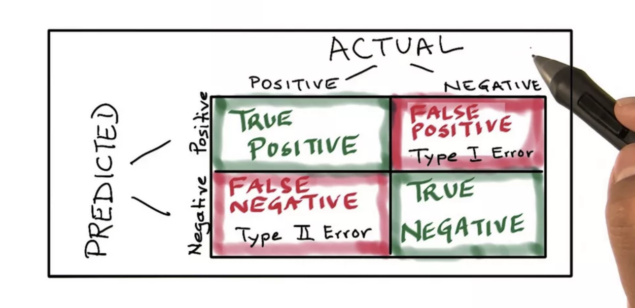
How do we evaluate Text Classification Model
Confusion Matrix

Slide 33
How do we evaluate Text Classification Model
Confusion Matrix

Slide 34
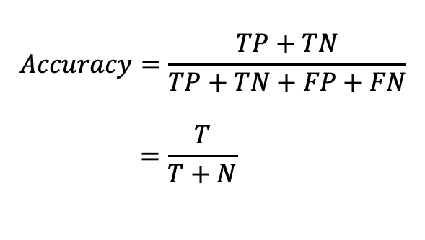
Classification Metric
1. Accuracy
Actual
$$Accuracy=\frac{TP+TN}{TP+TN+FP+FN} \\ =\frac{T}{T+N}$$
 | Positive | Negative
Positive | TP | FP
Negative | FN | TN
Predicted
전체적인 Classifier의 성능

Slide 35
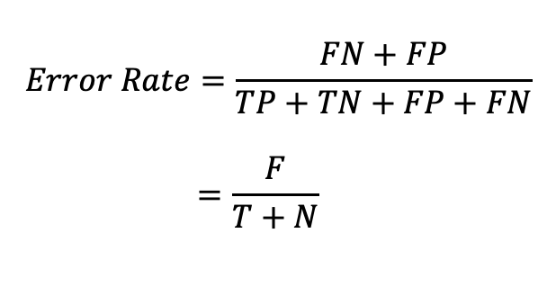
Classification Metric
2. Error Rate
Actual
$$Error Rate=\frac{FN+FP}{TP+TN+FP+FN} \\ =\frac{F}{T+N}$$
 | Positive | Negative
Positive | TP | FP
Negative | FN | TN
Predicted
Classification error

Slide 36
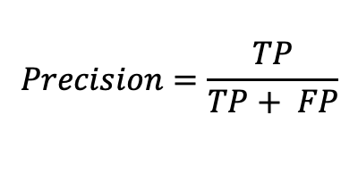
Classification Metric
3. Precision
Actual
$$Precision=\frac{TP}{TP+ FP}$$
 | Positive | Negative
Positive | TP | FP
Negative | FN | TN
Predicted
Classifier가 Positive로 예측한 값 중 실제 Positive 비율

Slide 37
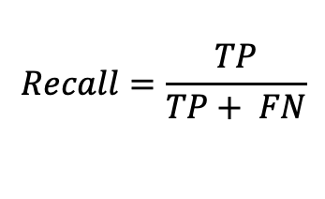
Classification Metric
4. Sensitivity (or Recall or True Positive Rate, TPR)
Actual
$$Recall=\frac{TP}{TP+ FN}$$
 | Positive | Negative
Positive | TP | FP
Negative | FN | TN
Predicted
실제 Positive인 값을 얼마나 잘 분류하는지 측정하는 척도

Slide 38
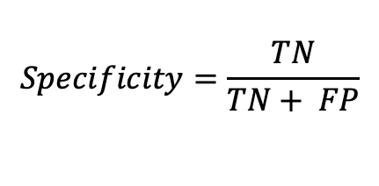
Classification Metric
5. Specificity (or True Negative Rate, TNR)
Actual
$$Specificity=\frac{TN}{TN+ FP}$$
 | Positive | Negative
Positive | TP | FP
Negative | FN | TN
Predicted
실제 Negative인 값을 얼마나 잘 분류하는지 측정하는 척도

Slide 39
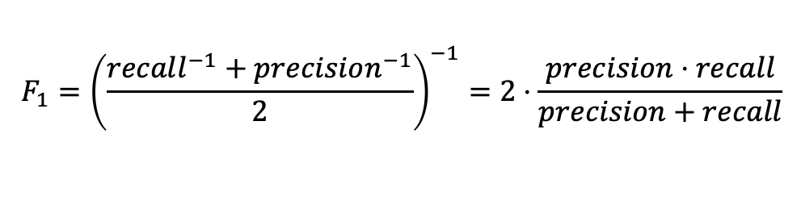
Classification Metric
6. F1 Score
$$F_{1}={\left(\frac{recall^{−1}+precision^{−1}}{2}\right)}^{−1}=2⋅\frac{precision⋅recall}{precision+recall}$$
Recall과 Precision의 조화 평균(Harmonic mean)
(조화 평균: 역수의 평균의 역수)

Slide 40
Classification Metric
6. F1 Score
$$F_{1}={\left(\frac{recall^{−1}+precision^{−1}}{2}\right)}^{−1}=2⋅\frac{precision⋅recall}{precision+recall}$$
Recall과 Precision의 조화 평균(Harmonic mean)
(조화 평균: 역수의 평균의 역수)
Imbalanced Data 성능 측정 시 유용

Slide 41
Classification Metric
6. F1 Score
$$F_{1}={\left(\frac{recall^{−1}+precision^{−1}}{2}\right)}^{−1}=2⋅\frac{precision⋅recall}{precision+recall}$$
Recall과 Precision의 조화 평균(Harmonic mean)
(조화 평균: 역수의 평균의 역수)
Imbalanced Data 성능 측정 시 유용

Slide 42
Classification Metric
6. F1 Score
$$F_{1}={\left(\frac{recall^{−1}+precision^{−1}}{2}\right)}^{−1}=2⋅\frac{precision⋅recall}{precision+recall}$$
Recall과 Precision의 조화 평균(Harmonic mean)
(조화 평균: 역수의 평균의 역수)
Imbalanced Data 성능 측정 시 유용
큰 값에 Penalty

Slide 43
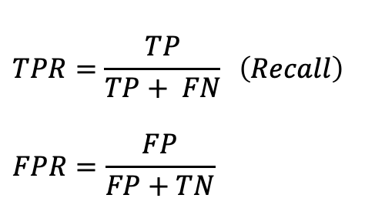
Classification Metric
6. AUC ROC
$$TPR=\frac{TP}{TP+ FN} \left(Recall\right)$$
$$FPR=\frac{FP}{FP+TN}$$

Slide 44
How does Classification work

Slide 45
How does Classification work
Input Data
Output
Text Data

Slide 46
How does Classification work
Input Data
Output
Text Data
Classifier

Slide 47
How does Classification work
Input Data
Output
Text Data
Binary: 2-dimension vector or scalar
Multi: N-dimension vector
(N: number of classes)

Slide 48
How does Classification work
Input Data
Output
Text Data
How Represent?

Slide 49
How does Classification work
Input Data
Output
Text Data
How Represent?
Text Representation in Lecture 2!

Slide 50
Classification Papers

Slide 51
Classification Papers
Convolutional neural networks for sentence classification
Character-level Convolutional Networks for Text Classification

Slide 52
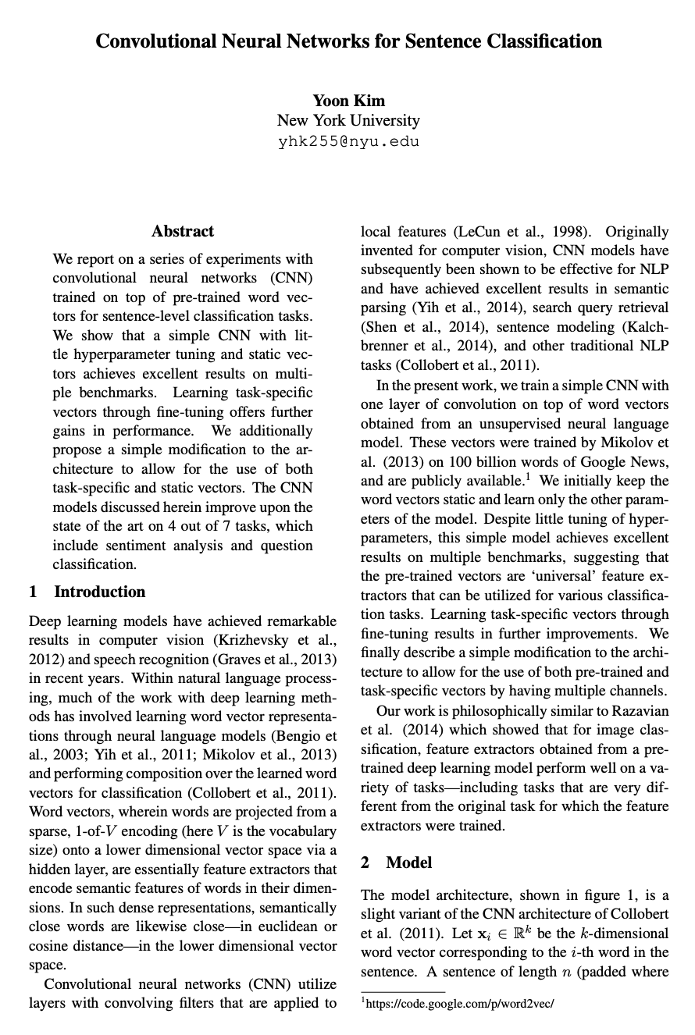
Convolutional neural networks for sentence classification
Yoon kim(2014)
매우 간단한 모델임에도 괜찮은 성능을 보임
Embedding vector사용에 대해 여러가지 실험을 진행
Classification Task의 총 6개 Dataset에 대해서 진행

Slide 53
Convolutional neural networks for sentence classification
Model Architecture

Slide 54
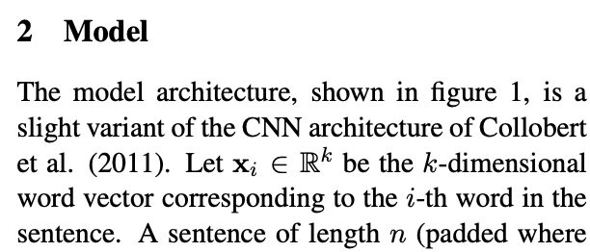
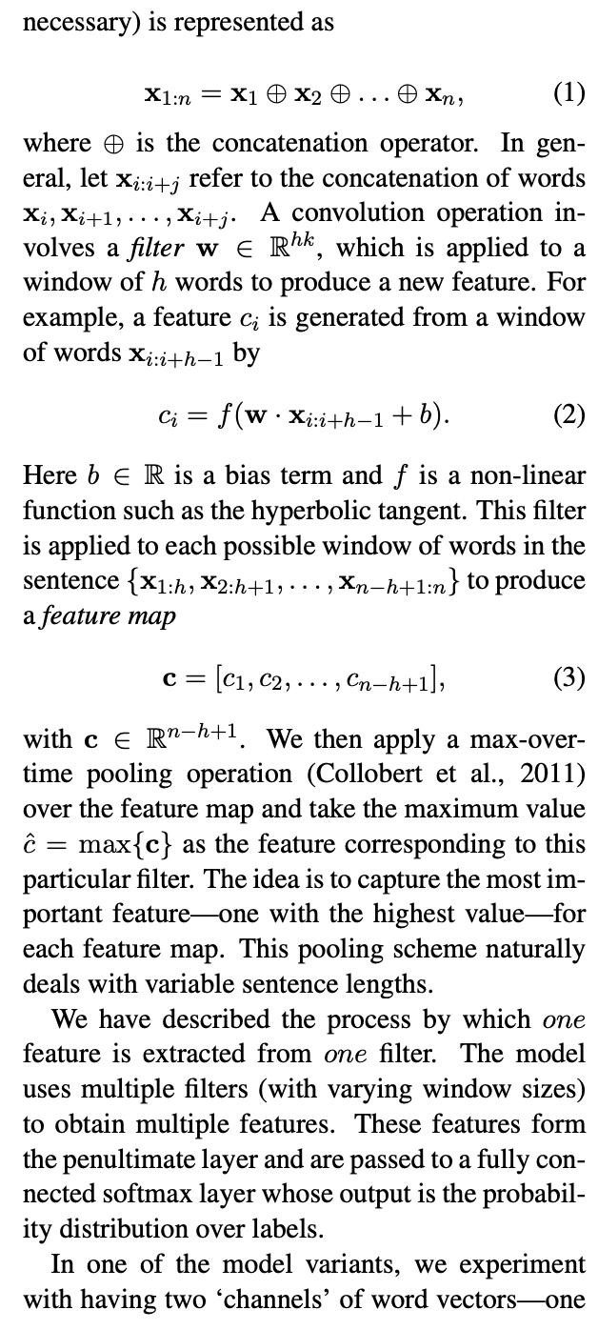
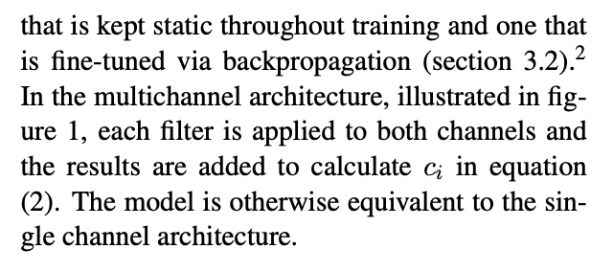
Convolutional neural networks for sentence classification
Model Architecture

Slide 55
Convolutional neural networks for sentence classification
Model Architecture

Slide 56
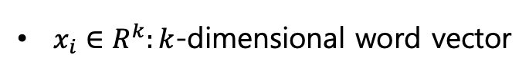
Convolutional neural networks for sentence classification
Model Architecture
$x_{i}∈R^{k}:k$-dimensional word vector

Slide 57
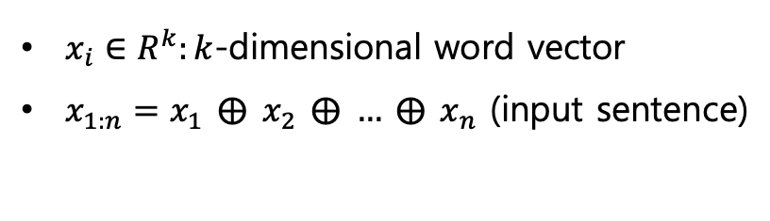
Convolutional neural networks for sentence classification
Model Architecture
$x_{i}∈R^{k}:k$-dimensional word vector
$x_{1:n}=x_{1} ⨁{ }x_{2} ⨁{ }… ⨁{ }x_{n}$ (input sentence)

Slide 58
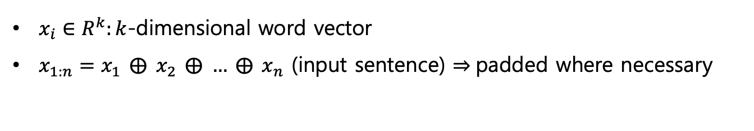
Convolutional neural networks for sentence classification
Model Architecture
$x_{i}∈R^{k}:k$-dimensional word vector
$x_{1:n}=x_{1} ⨁{ }x_{2} ⨁{ }… ⨁{ }x_{n}$ (input sentence) $⇒$padded where necessary

Slide 59
Convolutional neural networks for sentence classification
Model Architecture
$x_{i}∈R^{k}:k$-dimensional word vector
$x_{1:n}=x_{1} ⨁{ }x_{2} ⨁{ }… ⨁{ }x_{n}$ (input sentence) $⇒$padded where necessary

Slide 60
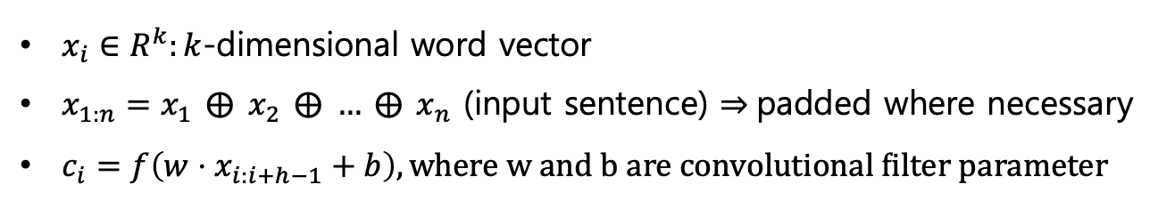
Convolutional neural networks for sentence classification
Model Architecture
$x_{i}∈R^{k}:k$-dimensional word vector
$x_{1:n}=x_{1} ⨁{ }x_{2} ⨁{ }… ⨁{ }x_{n}$ (input sentence) $⇒$padded where necessary
$c_{i}=f\left(w⋅x_{i:i+h−1}+b\right), where w and b are convolutional filter parameter$

Slide 61
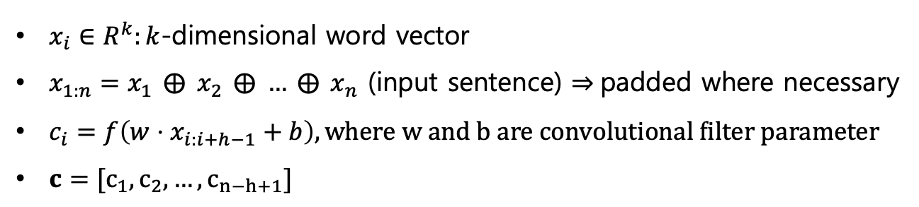
Convolutional neural networks for sentence classification
Model Architecture
$x_{i}∈R^{k}:k$-dimensional word vector
$x_{1:n}=x_{1} ⨁{ }x_{2} ⨁{ }… ⨁{ }x_{n}$ (input sentence) $⇒$padded where necessary
$c_{i}=f\left(w⋅x_{i:i+h−1}+b\right), where w and b are convolutional filter parameter$
$c=[c_{1}, c_{2}, …, c_{n−h+1}]$

Slide 62
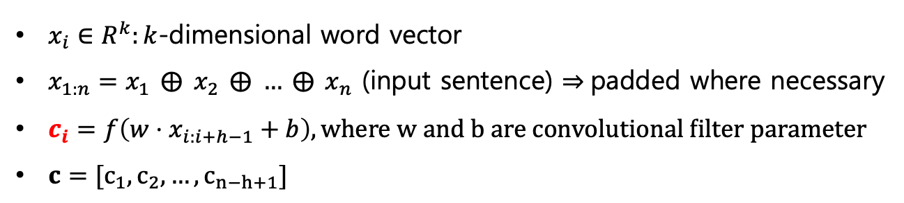
Convolutional neural networks for sentence classification
Model Architecture
$x_{i}∈R^{k}:k$-dimensional word vector
$x_{1:n}=x_{1} ⨁{ }x_{2} ⨁{ }… ⨁{ }x_{n}$ (input sentence) $⇒$padded where necessary
$c_{i}=f\left(w⋅x_{i:i+h−1}+b\right), where w and b are convolutional filter parameter$
$c=[c_{1}, c_{2}, …, c_{n−h+1}]$

Slide 63
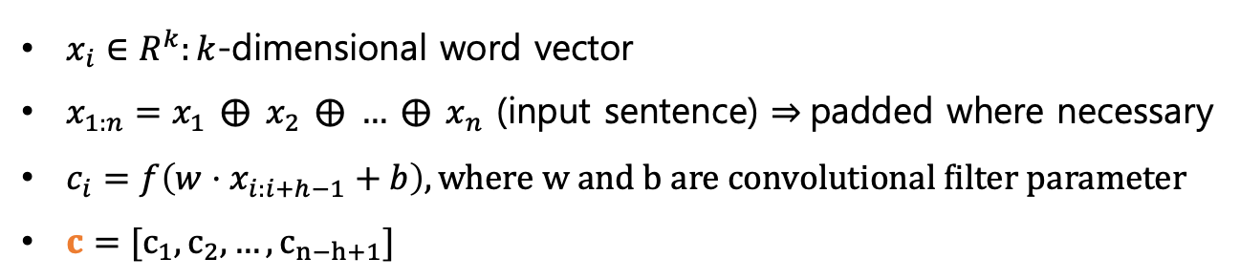
Convolutional neural networks for sentence classification
Model Architecture
$x_{i}∈R^{k}:k$-dimensional word vector
$x_{1:n}=x_{1} ⨁{ }x_{2} ⨁{ }… ⨁{ }x_{n}$ (input sentence) $⇒$padded where necessary
$c_{i}=f\left(w⋅x_{i:i+h−1}+b\right), where w and b are convolutional filter parameter$
$c=[c_{1}, c_{2}, …, c_{n−h+1}]$

Slide 64
Convolutional neural networks for sentence classification
Model Architecture
max-pooling & fully connected layer
$x_{i}∈R^{k}:k$-dimensional word vector
$x_{1:n}=x_{1} ⨁{ }x_{2} ⨁{ }… ⨁{ }x_{n}$ (input sentence) $⇒$padded where necessary
$c_{i}=f\left(w⋅x_{i:i+h−1}+b\right), where w and b are convolutional filter parameter$
$c=[c_{1}, c_{2}, …, c_{n−h+1}]$

Slide 65
Convolutional neural networks for sentence classification
Regularization

Slide 66
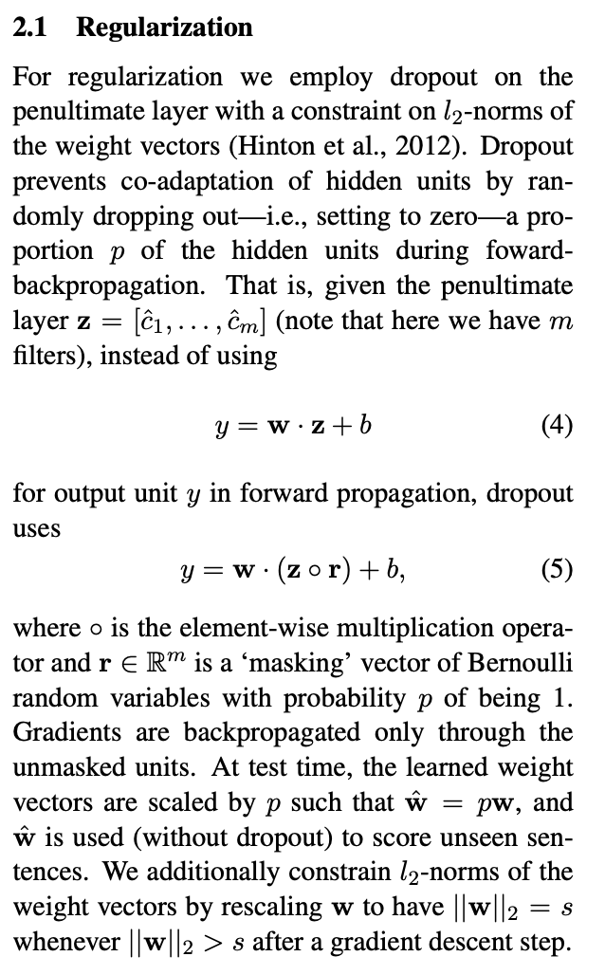
Convolutional neural networks for sentence classification
Regularization

Slide 67
Convolutional neural networks for sentence classification
Regularization
Dropout
Clipping weight by L2-norm

Slide 68
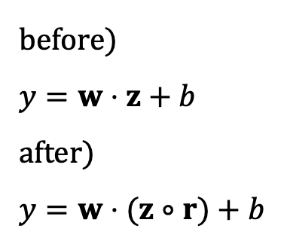
Convolutional neural networks for sentence classification
Regularization
Dropout
Clipping weight by L2-norm
before)
$$y=w⋅z+b$$
after)
$$y=w⋅(z∘r)+b$$

Slide 69
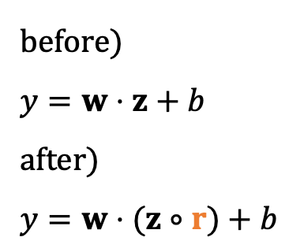
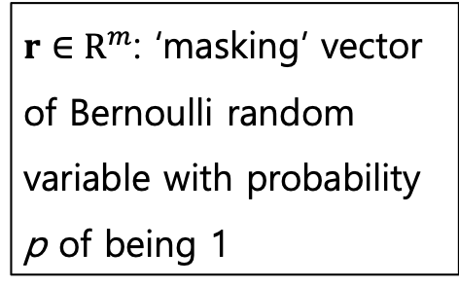
Convolutional neural networks for sentence classification
Regularization
Dropout
Clipping weight by L2-norm
before)
$$y=w⋅z+b$$
after)
$$y=w⋅(z∘r)+b$$
$r∈R^{m}$: ‘masking’ vector of Bernoulli random variable with probability p of being 1

Slide 70

Convolutional neural networks for sentence classification
Regularization
Dropout
Clipping weight by L2-norm
before)
$$y=w⋅z+b$$
after)
$$y=w⋅(z∘r)+b$$
0.3
-0.4
0.5
1.2
0.04
-0.2
-1.4
0.84
$$z$$

Slide 71
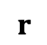
Convolutional neural networks for sentence classification
Regularization
Dropout
Clipping weight by L2-norm
before)
$$y=w⋅z+b$$
after)
$$y=w⋅(z∘r)+b$$
0.3
-0.4
0.5
1.2
0.04
-0.2
-1.4
0.84
1
0
1
1
1
0
1
0
$$z$$
$$r$$

Slide 72

Convolutional neural networks for sentence classification
Regularization
Dropout
Clipping weight by L2-norm
before)
$$y=w⋅z+b$$
after)
$$y=w⋅(z∘r)+b$$
0.3
-0.4
0.5
1.2
0.04
-0.2
-1.4
0.84
1
0
1
1
1
0
1
0
$$∘$$
$$z$$
$$r$$

Slide 73
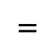
Convolutional neural networks for sentence classification
Regularization
Dropout
Clipping weight by L2-norm
before)
$$y=w⋅z+b$$
after)
$$y=w⋅(z∘r)+b$$
0.3
-0.4
0.5
1.2
0.04
-0.2
-1.4
0.84
1
0
1
1
1
0
1
0
0.3
0
0.5
1.2
0.04
0
-1.4
0
$$∘$$
$$=$$
$$z$$
$$r$$

Slide 74
Convolutional neural networks for sentence classification
Regularization
Dropout
Clipping weight by L2-norm

Slide 75
Convolutional neural networks for sentence classification
Regularization
Dropout
Clipping weight by L2-norm
vector의 크기
L1-norm
L2-norm
p-norm

Slide 76
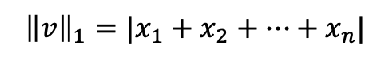
Convolutional neural networks for sentence classification
Regularization
Dropout
Clipping weight by L2-norm
vector의 크기
L1-norm
L2-norm
p-norm
$${\left\|v\right\|}_{1}=|x_{1}+x_{2}+…+x_{n}|$$

Slide 77
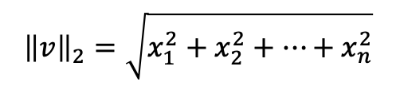
Convolutional neural networks for sentence classification
Regularization
Dropout
Clipping weight by L2-norm
vector의 크기
L1-norm
L2-norm
p-norm
$${\left\|v\right\|}_{2}=\sqrt{x_{1}^{2}+x_{2}^{2}+…+x_{n}^{2}}$$

Slide 78
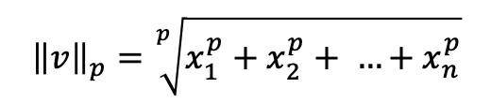
Convolutional neural networks for sentence classification
Regularization
Dropout
Clipping weight by L2-norm
vector의 크기
L1-norm
L2-norm
p-norm
$${\left\|v\right\|}_{p}=\sqrt[p]{x_{1}^{p}+x_{2}^{p}+ …+x_{n}^{p}}$$

Slide 79
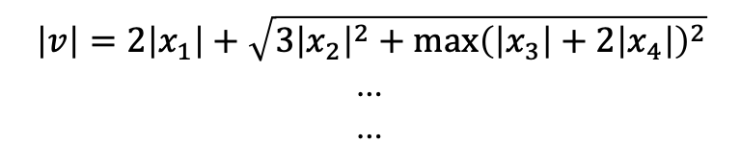
Convolutional neural networks for sentence classification
Regularization
Dropout
Clipping weight by L2-norm
vector의 크기
L1-norm
L2-norm
p-norm
etc
$$\left|v\right|=2\left|x_{1}\right|+\sqrt{3{\left|x_{2}\right|}^{2}+{\max\left(\left|x_{3}\right|+2\left|x_{4}\right|\right)}^{2}}$$
…
…

Slide 80
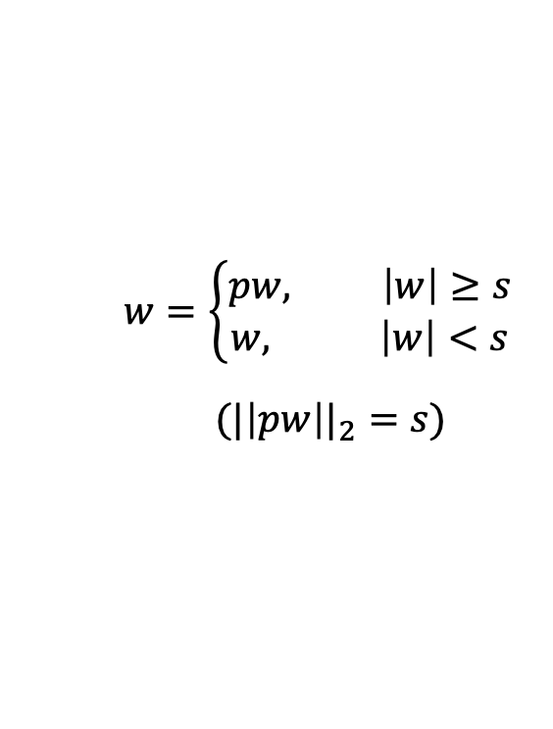
Convolutional neural networks for sentence classification
Regularization
Dropout
Clipping weight by L2-norm
$$w=\left\{\begin{aligned}pw, \left|w\right|≥s \\ &w, \left|w\right|<s\end{aligned}\right.$$
$$({|\left|pw\right||}_{2}=s)$$

Slide 81
Convolutional neural networks for sentence classification
Experimental Setup

Slide 82
Convolutional neural networks for sentence classification
Experimental Setup - Dataset
MR
SST
Subj
TREC
CR
MPQA

Slide 83
Convolutional neural networks for sentence classification
Experimental Setup - HyperParameters
filter window size = 3, 4, 5
100 filter maps
dropout rate = 0.5
L2 constraint = 3
batch size = 50

Slide 84
Convolutional neural networks for sentence classification
Experimental Setup - Pre-trained vector

Slide 85
Convolutional neural networks for sentence classification
Experimental Setup - Pre-trained vector

Slide 86
Convolutional neural networks for sentence classification
Experimental Setup - Pre-trained vector
CNN-rand
CNN-static
CNN-non-static
CNN-multichannel

Slide 87
Convolutional neural networks for sentence classification
Experimental Setup - Pre-trained vector
CNN-rand
CNN-static
CNN-non-static
CNN-multichannel
Randomly initialized

Slide 88
Convolutional neural networks for sentence classification
Experimental Setup - Pre-trained vector
CNN-rand
CNN-static
CNN-non-static
CNN-multichannel
Pre-trained by word2vec
& word vector doesn’t update during training

Slide 89
Convolutional neural networks for sentence classification
Experimental Setup - Pre-trained vector
CNN-rand
CNN-static
CNN-non-static
CNN-multichannel
Pre-trained by word2vec
& word vector update during training

Slide 90
Convolutional neural networks for sentence classification
Experimental Setup - Pre-trained vector
CNN-rand
CNN-static
CNN-non-static
CNN-multichannel
Static + Non-Static

Slide 91
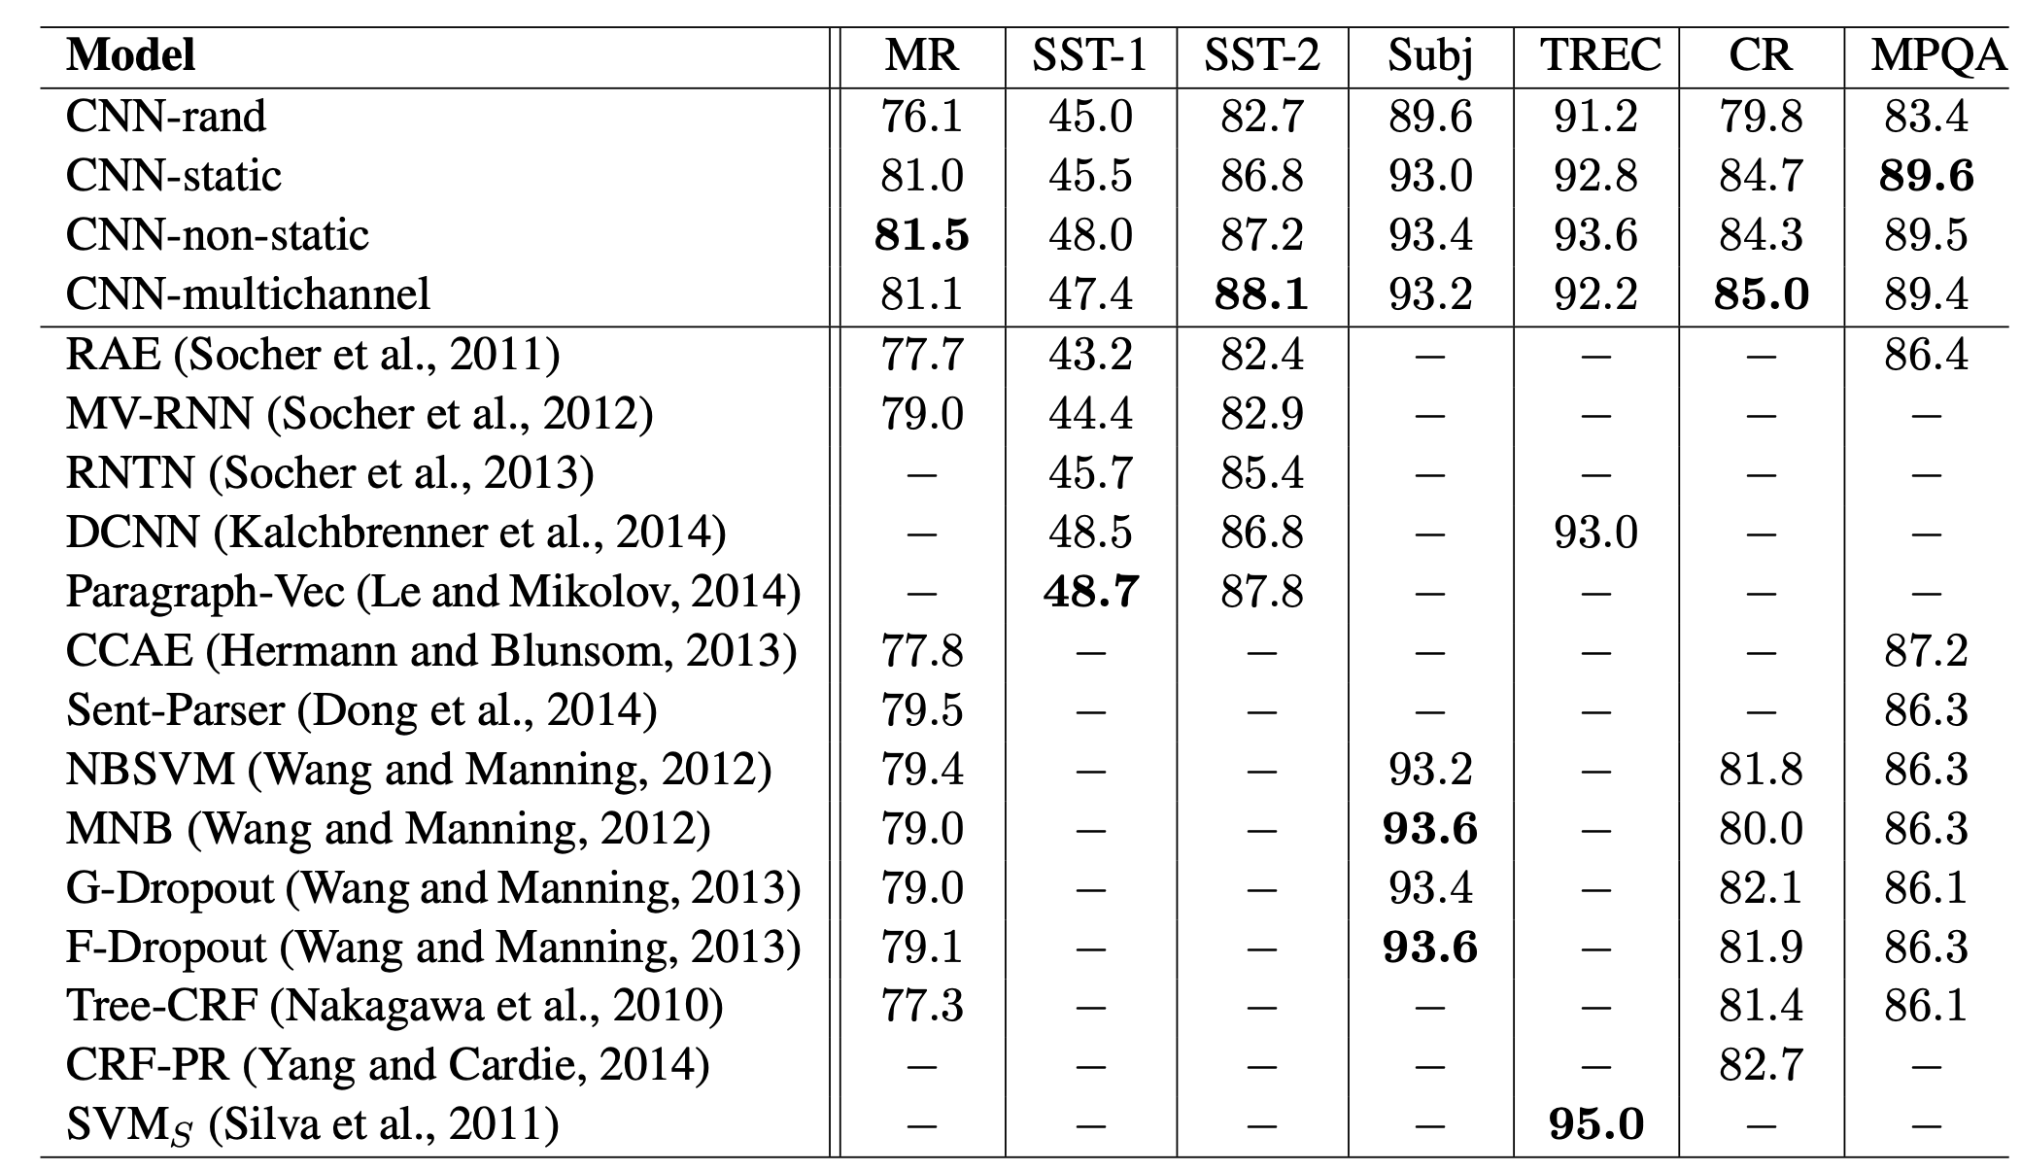
Convolutional neural networks for sentence classification
Experimental Setup - Result

Slide 92
Convolutional neural networks for sentence classification
Pre-trained vs Random initialize

Slide 93
Convolutional neural networks for sentence classification
Case by case !
Pre-trained vs Random initialize

Slide 94
Convolutional neural networks for sentence classification
But generally
Pre-trained vs Random initialize
Enough data
Small data

Slide 95
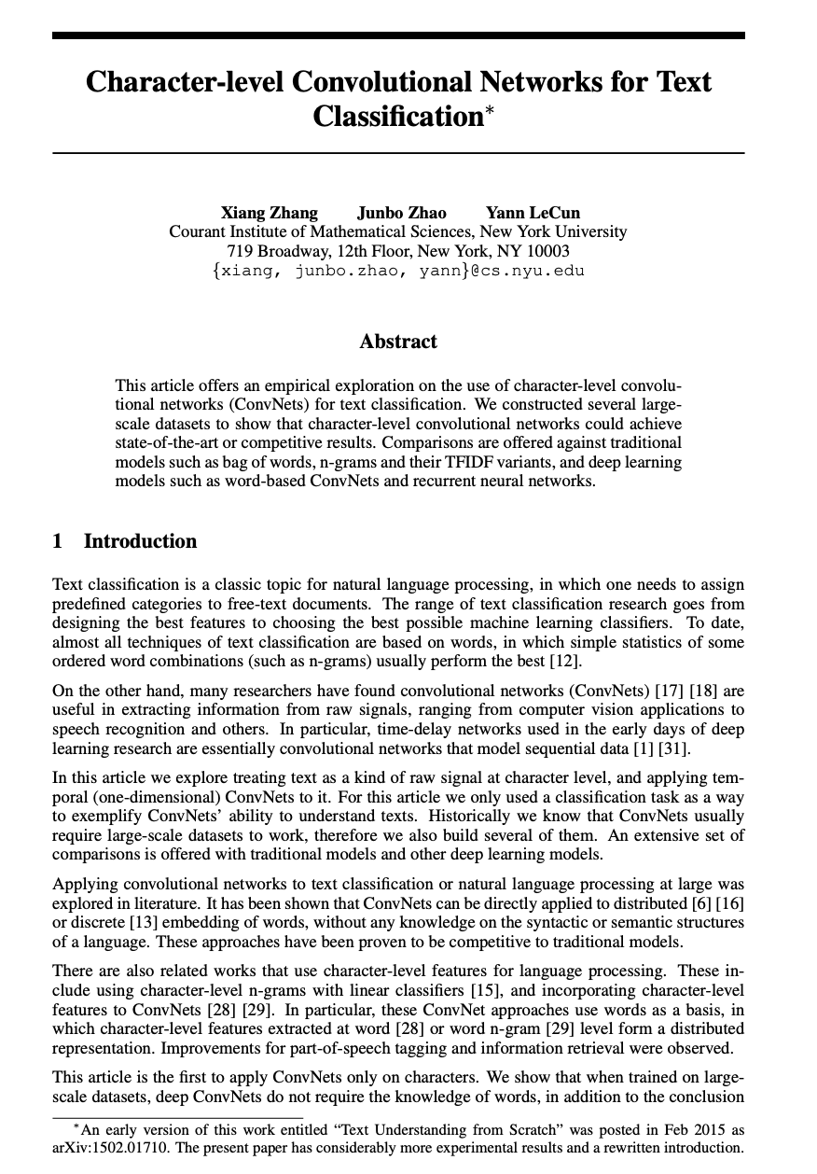
Character-level Convolutional Networks for Text Classification
X Zhang et al. (2015)
기존의 방법들은 word 단위였던 것과 달리 문자(Character) 단위로 입력 값 구성

Slide 96
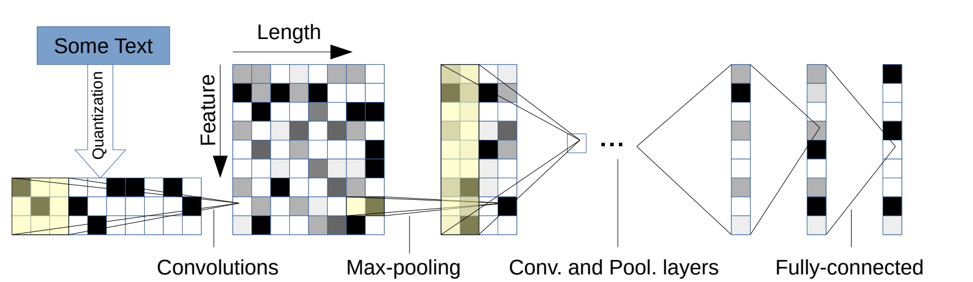
Character-level Convolutional Networks for Text Classification

Slide 97
Character-level Convolutional Networks for Text Classification

Slide 98
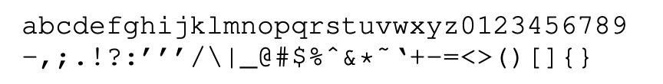
Character-level Convolutional Networks for Text Classification
Input Vocabulary

Slide 99
Character-level Convolutional Networks for Text Classification
Advantage of Character unit
Small vocabulary size
Good for misspelling
Good for Unseen word
Good for Informal text

